Slide 1
对抗样本非局部均值去噪
2020年4月12-19日
Xie, Cihang, Wu, Yuxin, van der Maaten, Laurens. Feature Denoising for Improving Adversarial Robustness. CVPR 2018

Slide 2
基础知识
Non-local means
Non-local neural network
Embedded Gaussian(Softmax)
ResNet-50 Feature Map

Slide 3
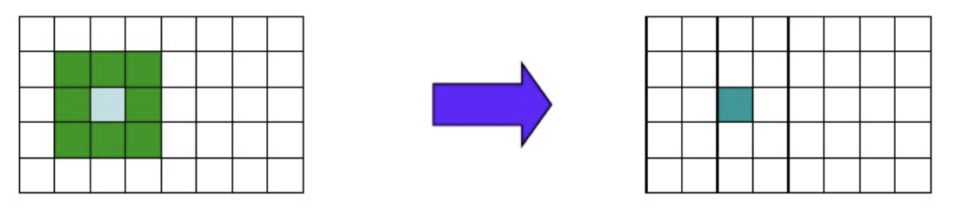
Non-local means (NLM，非局部均值滤波)
类型：空间域滤波
思想：当前像素点的值通过周围（特指图像中与当前像素区域具有相似结构的领域）像素的加权平均得到。
同类滤波器：means filter

Slide 4
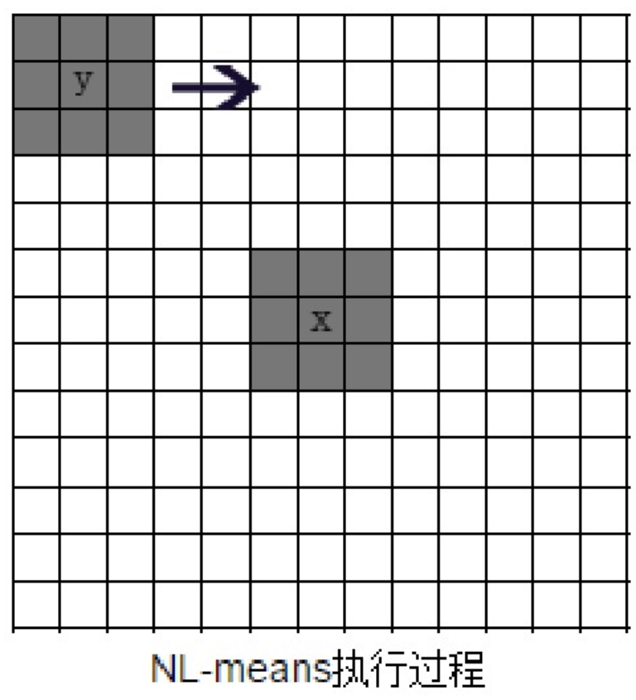
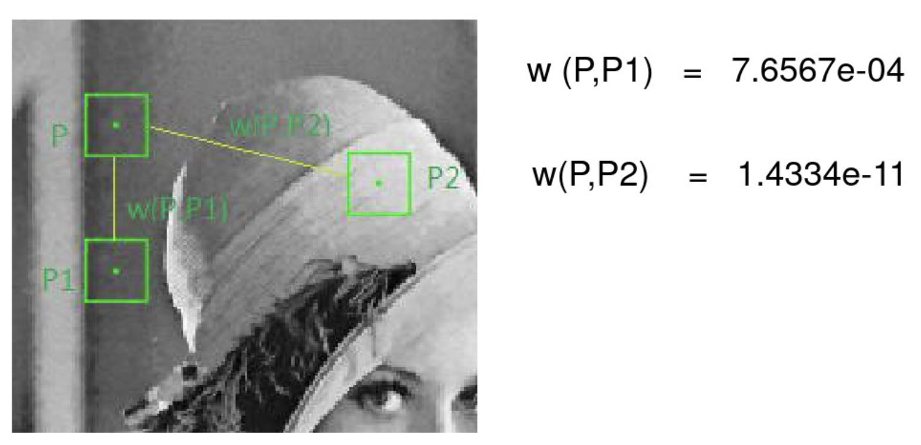
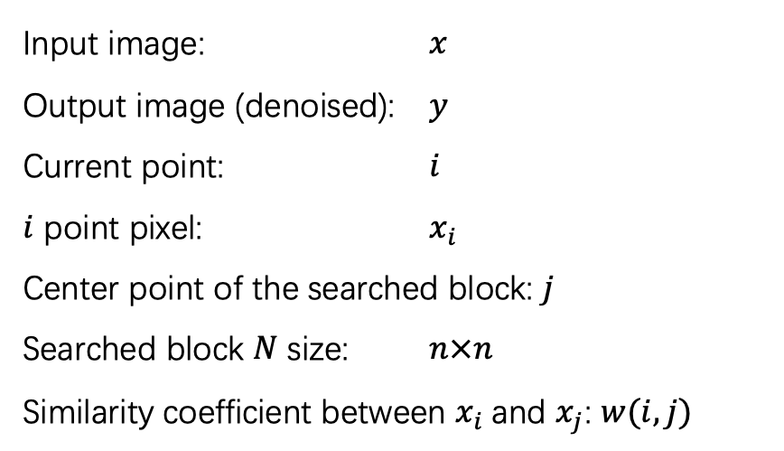
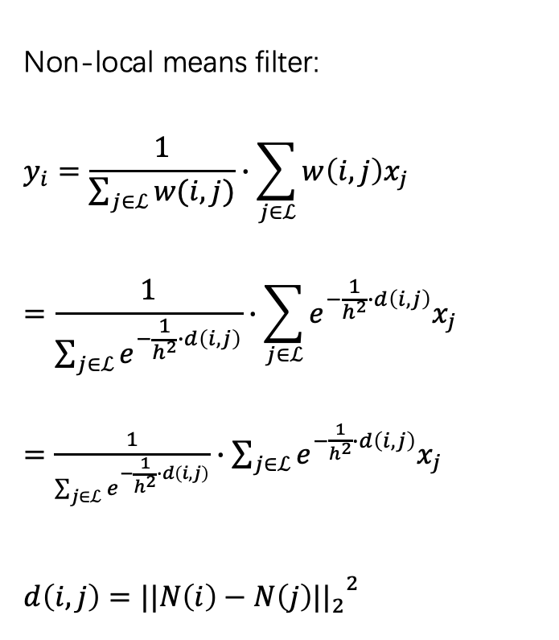
Non-local means (NLM，非局部均值滤波)
Input image: $x$
Output image (denoised): $y$
Current point: $i$
$i$ point pixel: $x_{i}$
Center point of the searched block: $j$
Searched block $N$ size: $n×n$
Similarity coefficient between $x_{i}$and $x_{j}$: $w(i,j)$
Non-local means filter:
$$y_{i}=\frac{1}{\sum_{j∈ℒ}{w(i,j)}}∙\sum_{j∈ℒ}{w\left(i,j\right)x_{j}}$$
$$=\frac{1}{\sum_{j∈ℒ}{e^{−\frac{1}{h^{2}}∙d\left(i,j\right)}}}∙\sum_{j∈ℒ}{e^{−\frac{1}{h^{2}}∙d\left(i,j\right)}x_{j}}$$
$=$ $\frac{1}{\sum_{j∈ℒ}{e^{−\frac{1}{h^{2}}∙d\left(i,j\right)}}}∙\sum_{j∈ℒ}{e^{−\frac{1}{h^{2}}∙d\left(i,j\right)}x_{j}}$
$$d\left(i,j\right)={{||N\left(i\right)−N\left(j\right)||}_{2}}^{2}$$

Slide 5
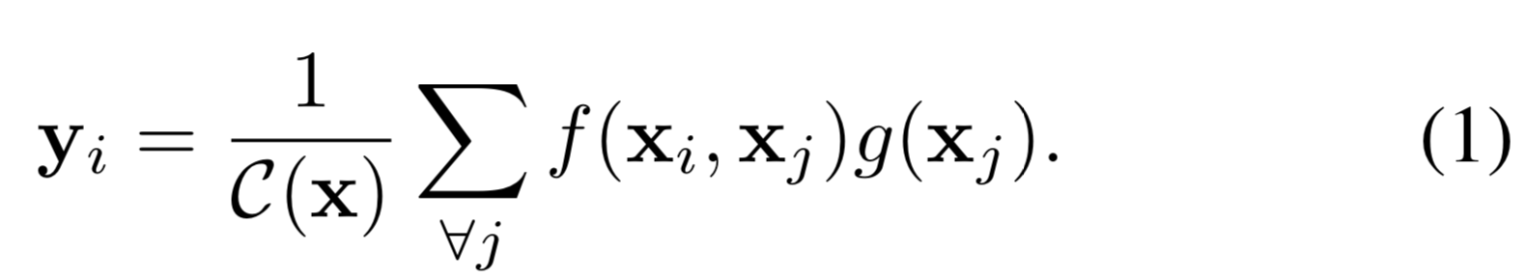
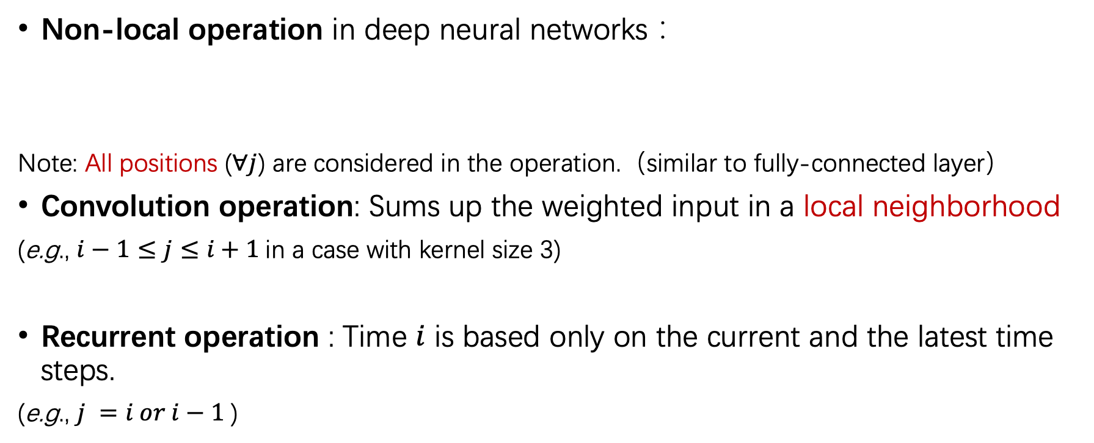
Non-local Neural Networks [24]
Non-local operation in deep neural networks：
Note: All positions ($∀j$) are considered in the operation.（similar to fully-connected layer）
Convolution operation: Sums up the weighted input in a local neighborhood
(e.g., $i−1≤j≤i+1$in a case with kernel size 3)
Recurrent operation : Time $i$ is based only on the current and the latest time steps.
(e.g., $j =i or i−1$)
https://img2018.cnblogs.com/blog/1093303/201901/1093303-20190120113539659-455066516.gif
[24] X.Wang, R.Girshick, A.Gupta, and K.He. Non-local neural networks. In CVPR, 2018.

Slide 6
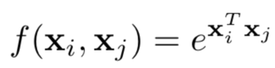
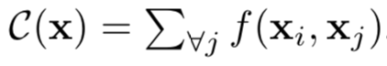
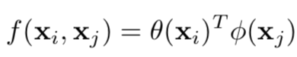
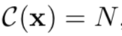
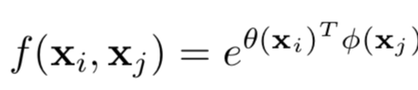
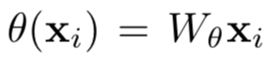
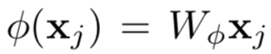
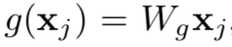
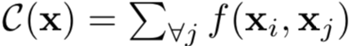
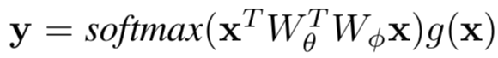
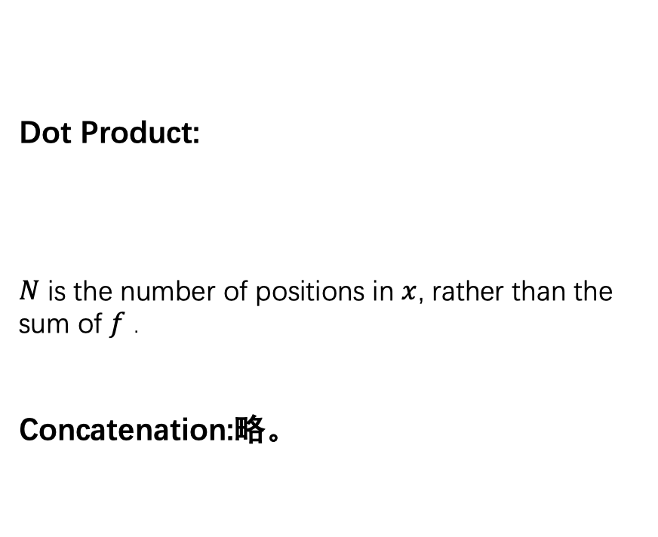
Four versions of Non-local operation[24]
Gaussian:
Embedded Gaussian:
Dot Product:
$N$ is the number of positions in $x$, rather than the sum of $f$ .
Concatenation:略。
Softmax computation
Self-attention form [23]
[24] X.Wang, R.Girshick, A.Gupta, and K.He. Non-local neural networks. In CVPR, 2018.

Slide 7
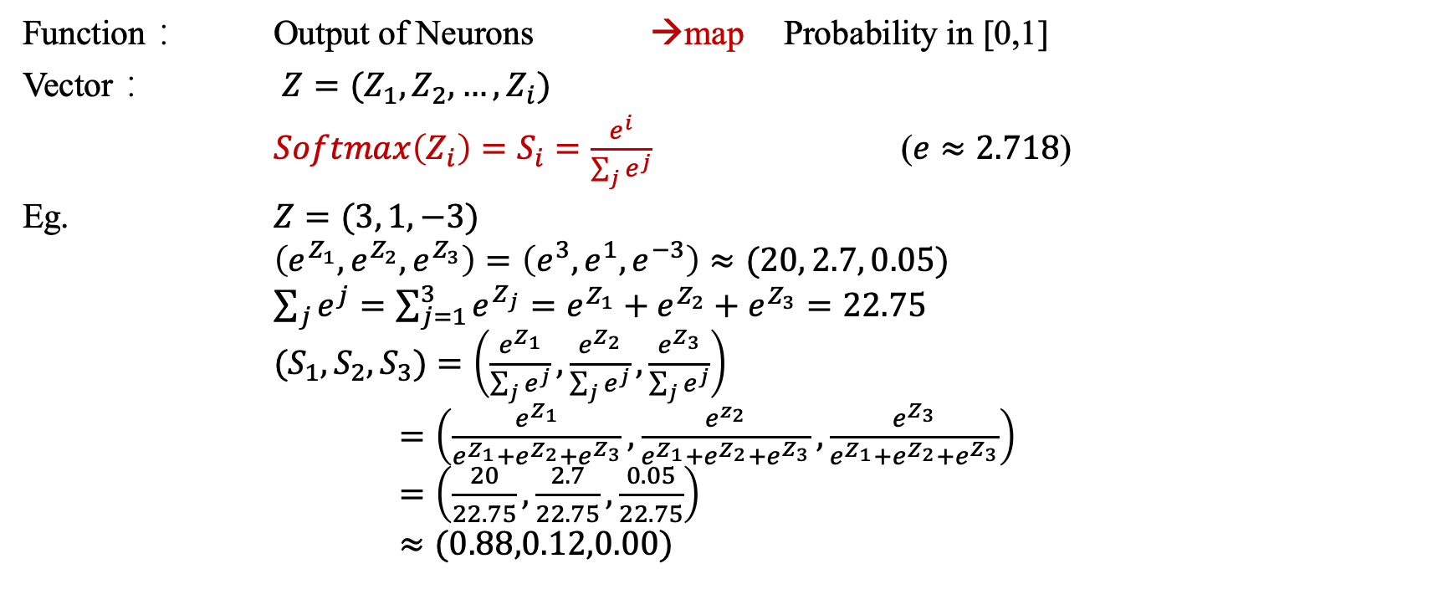
Softmax Function
Function： Output of Neurons →map Probability in [0,1]
Vector： $Z=(Z_{1},Z_{2},…,Z_{i})$
$Softmax\left(Z_{i}\right)=S_{i}=\frac{e^{i}}{\sum_{j}{e^{j}}}$ ($e≈2.718$)
Eg. $Z=(3, 1, −3)$
$\left(e^{Z_{1}},e^{Z_{2}},e^{Z_{3}}\right)=\left(e^{3},e^{1},e^{−3}\right)≈(20, 2.7, 0.05)$
$\sum_{j}{e^{j}}=\sum_{j=1}^{3}{e^{Z_{j}}}=e^{Z_{1}}+e^{Z_{2}}+e^{Z_{3}}=22.75$
${(S}_{1},S_{2},S_{3})=\left(\frac{e^{Z_{1}}}{\sum_{j}{e^{j}}},\frac{e^{Z_{2}}}{\sum_{j}{e^{j}}},\frac{e^{Z_{3}}}{\sum_{j}{e^{j}}}\right)$
$=\left(\frac{e^{Z_{1}}}{e^{Z_{1}}+e^{Z_{2}}+e^{Z_{3}}},\frac{e^{z_{2}}}{e^{Z_{1}}+e^{Z_{2}}+e^{Z_{3}}},\frac{e^{Z_{3}}}{e^{Z_{1}}+e^{Z_{2}}+e^{Z_{3}}}\right)$
$=\left(\frac{20}{22.75},\frac{2.7}{22.75},\frac{0.05}{22.75}\right)$
$≈(0.88,0.12,0.00)$

Slide 8
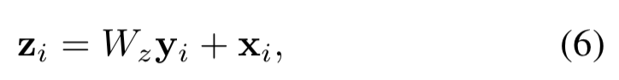
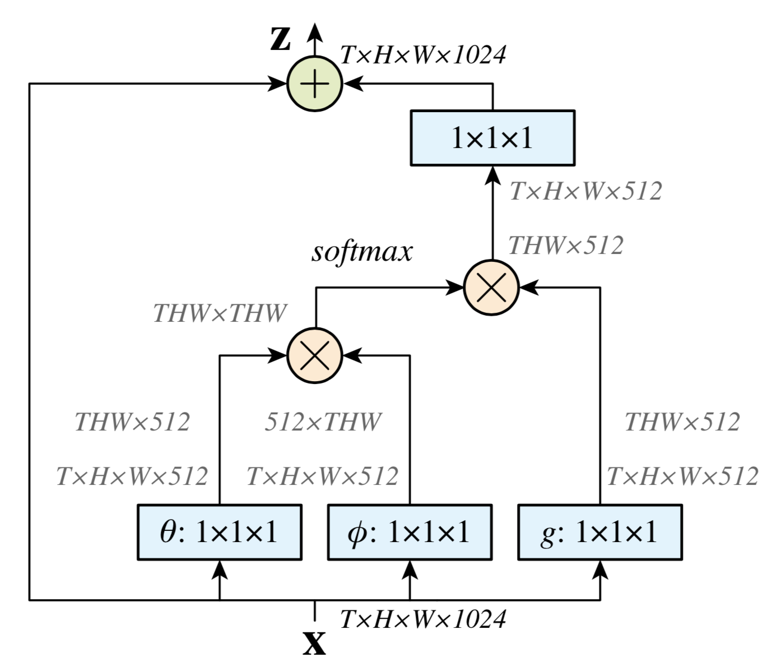
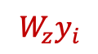
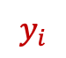
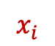
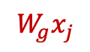
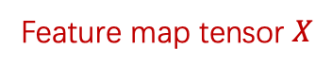
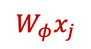
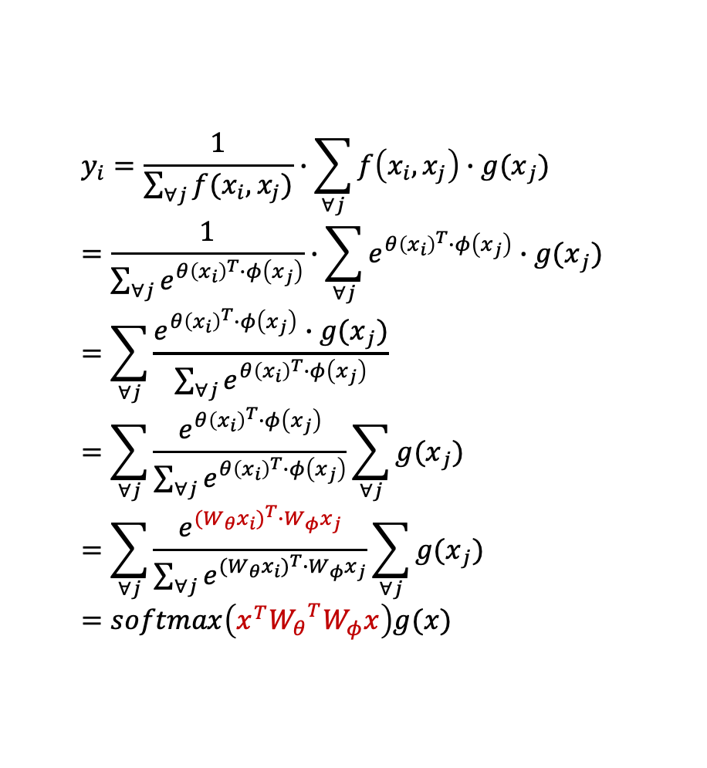

Non-local Block-embedded Gaussian
⊗ :matrix multiplication
⊕ :element-wise sum
$$y_{i}=\frac{1}{\sum_{∀j}{f(x_{i},x_{j})}}∙\sum_{∀j}{f\left(x_{i},x_{j}\right)∙{g(x}_{j})}=\frac{1}{\sum_{∀j}{e^{{θ\left(x_{i}\right)}^{T}∙φ\left(x_{j}\right)}}}∙\sum_{∀j}{e^{{θ\left(x_{i}\right)}^{T}∙φ\left(x_{j}\right)}∙{g(x}_{j})}=\sum_{∀j}{\frac{e^{{θ\left(x_{i}\right)}^{T}∙φ\left(x_{j}\right)}∙{g(x}_{j})}{\sum_{∀j}{e^{{θ\left(x_{i}\right)}^{T}∙φ\left(x_{j}\right)}}}}=\sum_{∀j}{\frac{e^{{θ\left(x_{i}\right)}^{T}∙φ\left(x_{j}\right)}}{\sum_{∀j}{e^{{θ\left(x_{i}\right)}^{T}∙φ\left(x_{j}\right)}}}\sum_{∀j}{{g(x}_{j})}}=\sum_{∀j}{\frac{e^{{{(W}_{θ}x_{i})}^{T}∙W_{φ}x_{j}}}{\sum_{∀j}{e^{{{(W}_{θ}x_{i})}^{T}∙W_{φ}x_{j}}}}\sum_{∀j}{{g(x}_{j})}}=softmax\left(x^{T}{W_{θ}}^{T}W_{φ}x\right)g(x)$$
$$W_{z}y_{i}$$
$$x_{i}$$
1024个1x1x512通道的卷积核
$$y_{i}$$
$$W_{θ}x_{i}$$
$$W_{φ}x_{j}$$
$$W_{g}x_{j}$$
512个1x1x1024通道的卷积核
Feature map tensor $X$
ResNet BottleNeck
[24] X.Wang, R.Girshick, A.Gupta, and K.He. Non-local neural networks. In CVPR, 2018.

Slide 9
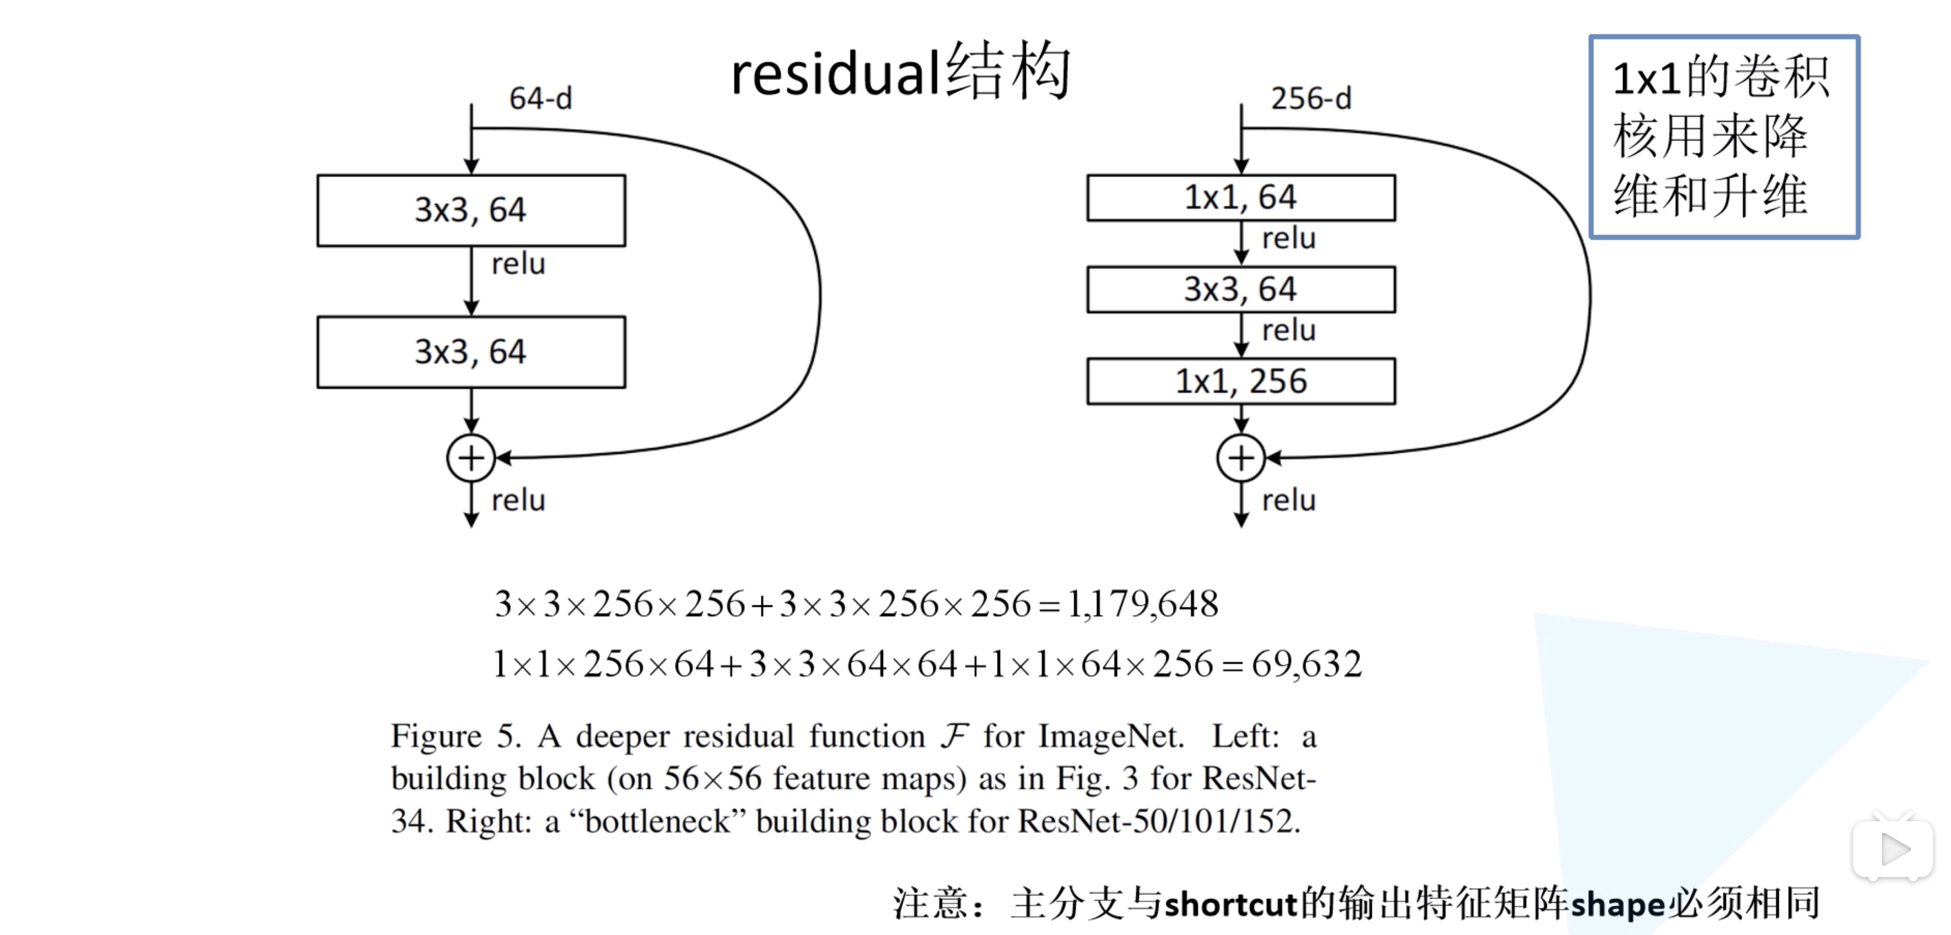
res₃ block in ResNet-50: a 3-layer bottleneck
Replace 2-layer building block with 3-layer bottleneck building block
训练参数减少
[9] K. He, X. Zhang, S. Ren, and J. Sun. Deep residual learning for image recognition. In CVPR, 2016

Slide 10
res₃ block in ResNet-50: a 3-layer bottleneck

Slide 11
res₃ block in ResNet-50: a 3-layer bottleneck

Slide 12
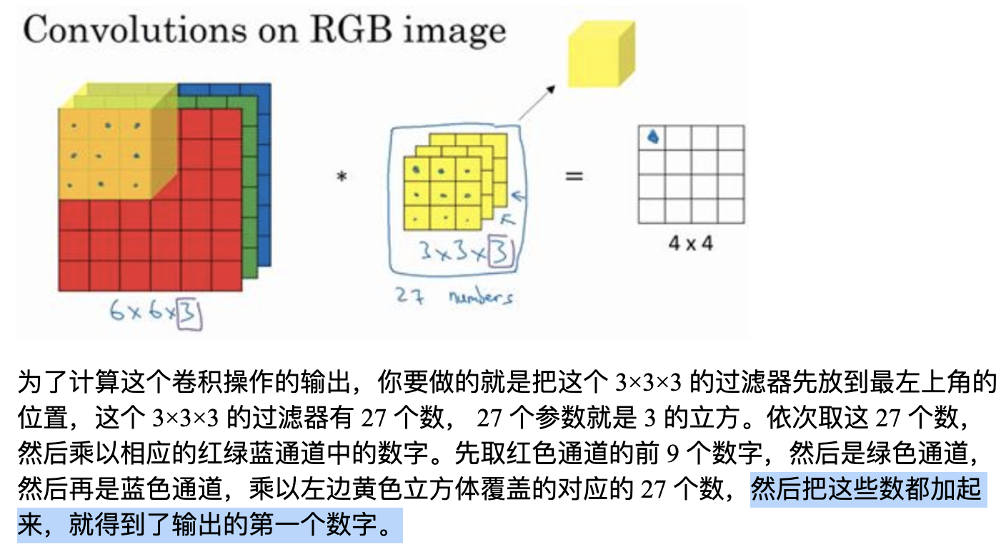
res₃ block in ResNet-50: a 3-layer bottleneck

Slide 13
Residual Network Backward Propagation

Slide 14
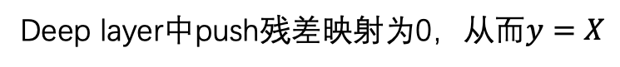
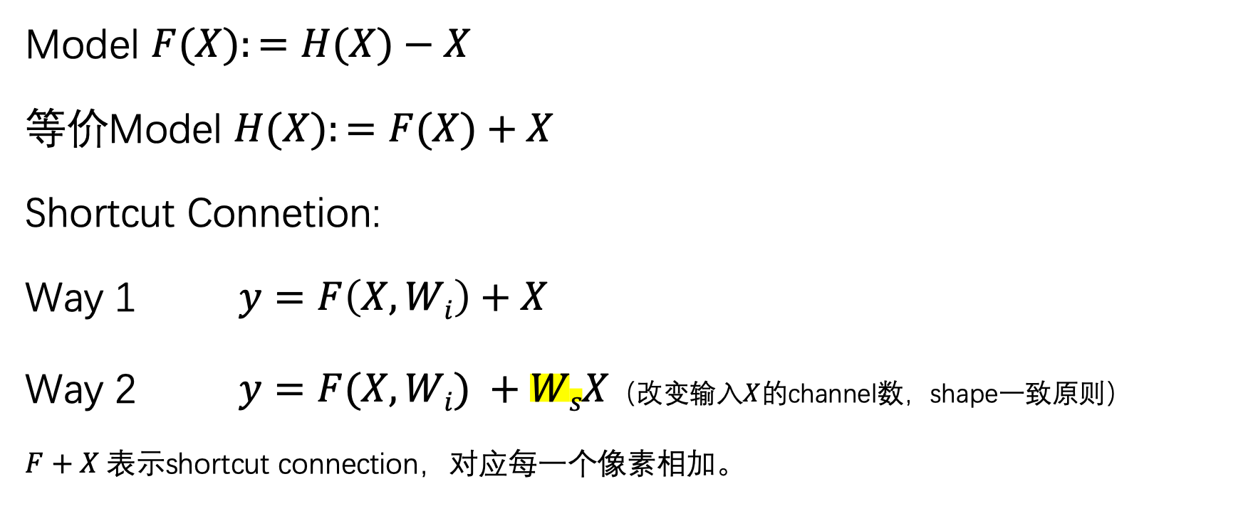
identity map(恒等映射)
Model $F(X):=H(X)−X$
等价Model $H(X):=F(X)+X$
Shortcut Connetion:
Way 1 $y=F\left(X,Wi\right)+X$
Way 2 $y=F(X,Wi) +WsX$（改变输入$X$的channel数，shape一致原则）
$F+X$表示shortcut connection，对应每一个像素相加。
Deep layer中push残差映射为0，从而$y=X$

Slide 15
Denoising Block
Denoising Block
Denoising Block
Denoising Block

Slide 16
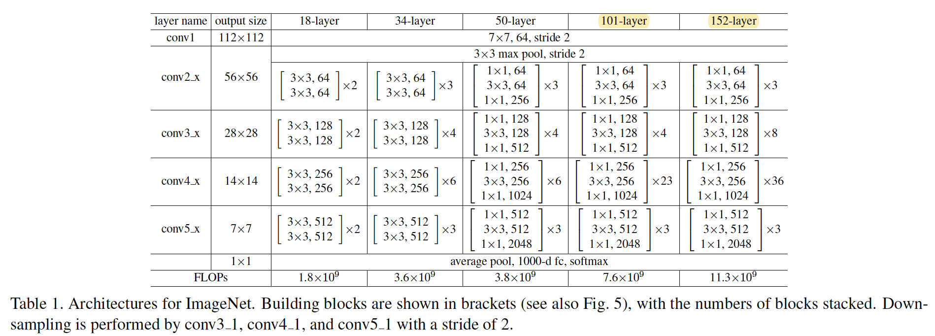
ResNet-18/34/50/101/152

Slide 17
对抗样本NLM去噪

Slide 18
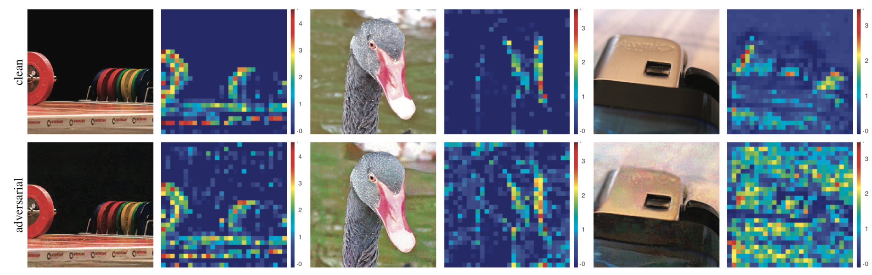
观察
Pixel Space
Feature Map
Xie, Cihang, Wu, Yuxin, van der Maaten, Laurens. Feature Denoising for Improving Adversarial Robustness. CVPR 2018

Slide 19
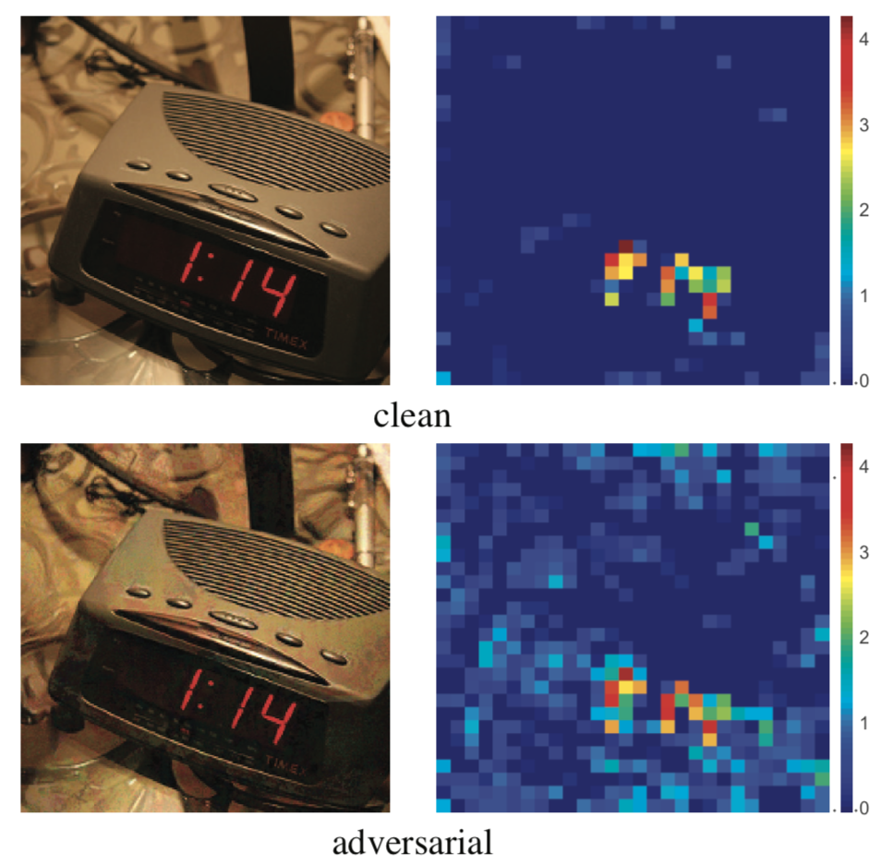
提出问题
Pixel Space
Feature Map
Feature Maps are extracted from the same channel of a res₃ block in the ResNet-50.
Hallucinated Activations:
For feature map, semantically irrelevant regions are activated.
Strong activations indicate the presence of semantic information about the image content[27]
[27] M. D. Zeiler and R. Fergus. Visualizing and understanding convolutional neural networks. In ECCV, 2014.

Slide 20
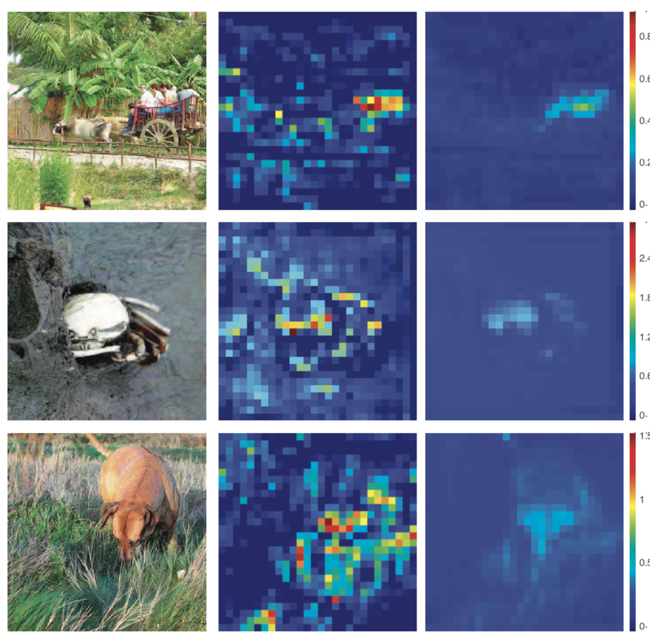
解决思路：Feature Denoising
Pixel Space
Feature Map
Feature Map
Make the responses focus on visually meaningful content.
Before denoising
After denoising
Xie, Cihang, Wu, Yuxin, van der Maaten, Laurens. Feature Denoising for Improving Adversarial Robustness. CVPR 2018

Slide 21
Design A Denoising Block
启发源1: self-attention transformer [23]
启发源2: non-local network [24]
[23] A. Vaswani, N. Shazeer, N. Parmar, J. Uszkoreit, L. Jones, A. N. Gomez, L. Kaiser, and I. Polosukhin. Attention is all you need. In NIPS, 2017.
[24] X.Wang, R.Girshick, A.Gupta, and K.He. Non-local neural networks. In CVPR, 2018.

Slide 22
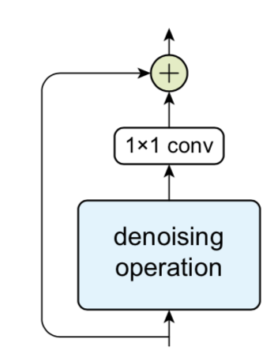
Design A Denoising Block
Adjust the tradeoff between removing noise and retaining signal
Residual Connection
(shortcut connection)
Denoising operation:
non-local means filters,
bilateral filters,
mean filters,
median filters
denoised representation
Denoising block
Input features: any feature layer in the CNN
Xie, Cihang, Wu, Yuxin, van der Maaten, Laurens. Feature Denoising for Improving Adversarial Robustness. CVPR 2018

Slide 23
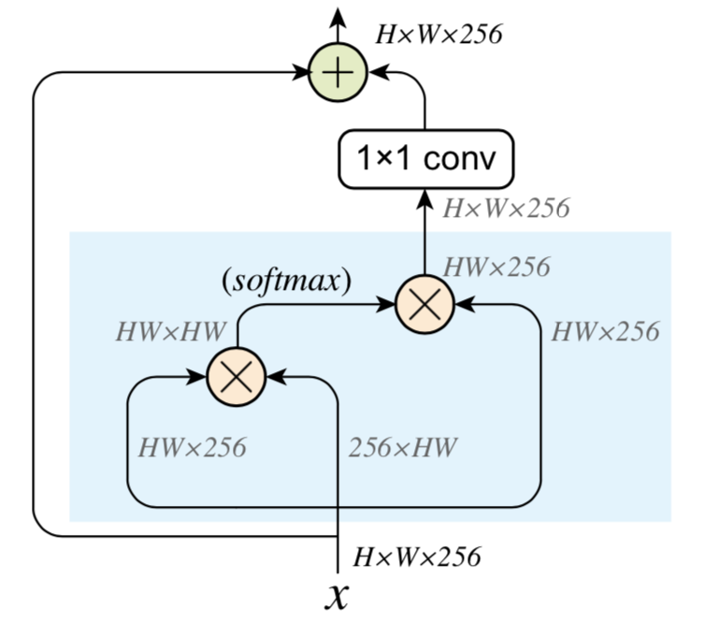
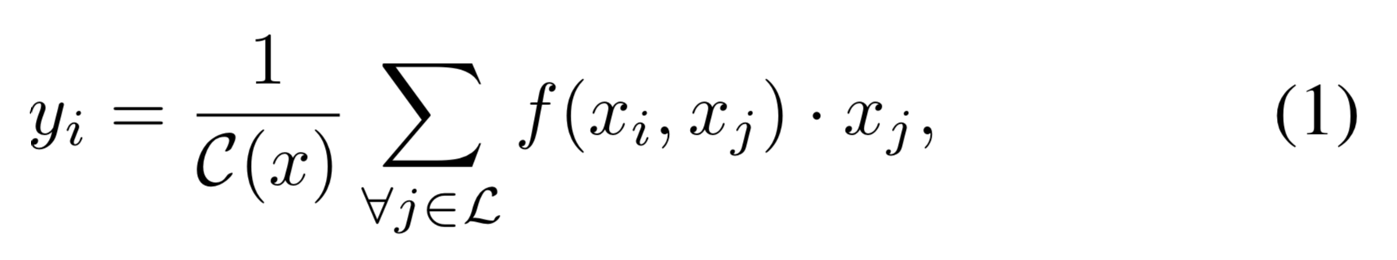
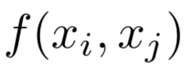
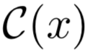

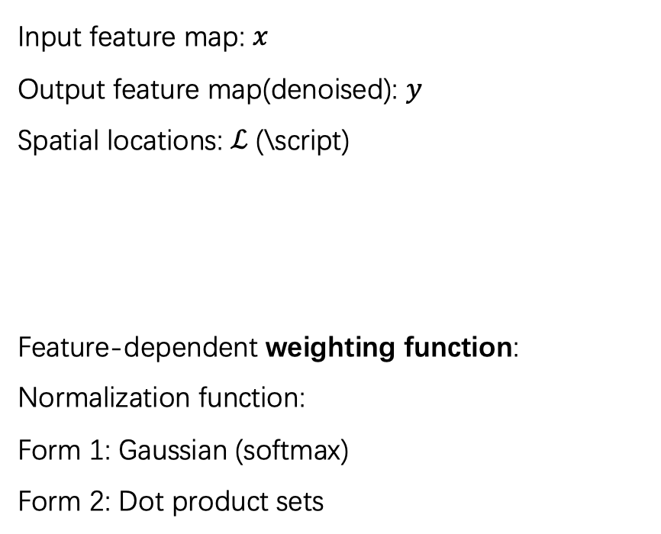
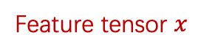
Denoising Block-Non-local Means Filter
Input feature map: $x$
Output feature map(denoised): $y$
Spatial locations: $ℒ$ (\script)
Feature-dependent weighting function:
Normalization function:
Form 1: Gaussian (softmax)
Form 2: Dot product sets
256个1x1x256通道的卷积核
$$y$$
Weight matrix(没有channel)
Height: H
Width: W
Channel:256
Feature tensor $x$
Xie, Cihang, Wu, Yuxin, van der Maaten, Laurens. Feature Denoising for Improving Adversarial Robustness. CVPR 2018

Slide 24
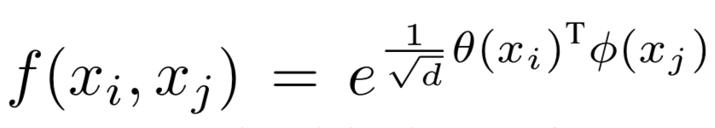
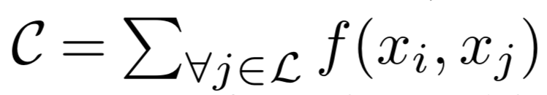
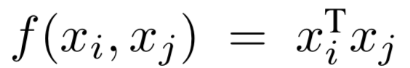
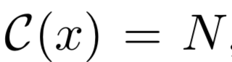
Denoising Block-Non-local Means Filter
Feature-dependent weighting function:
Normalization function:
Form 1: Gaussian (softmax)
Form 2: Dot product
$$y$$
Height: H
Width: W
Channel:256
Feature tensor $x$
Xie, Cihang, Wu, Yuxin, van der Maaten, Laurens. Feature Denoising for Improving Adversarial Robustness. CVPR 2018

Slide 25
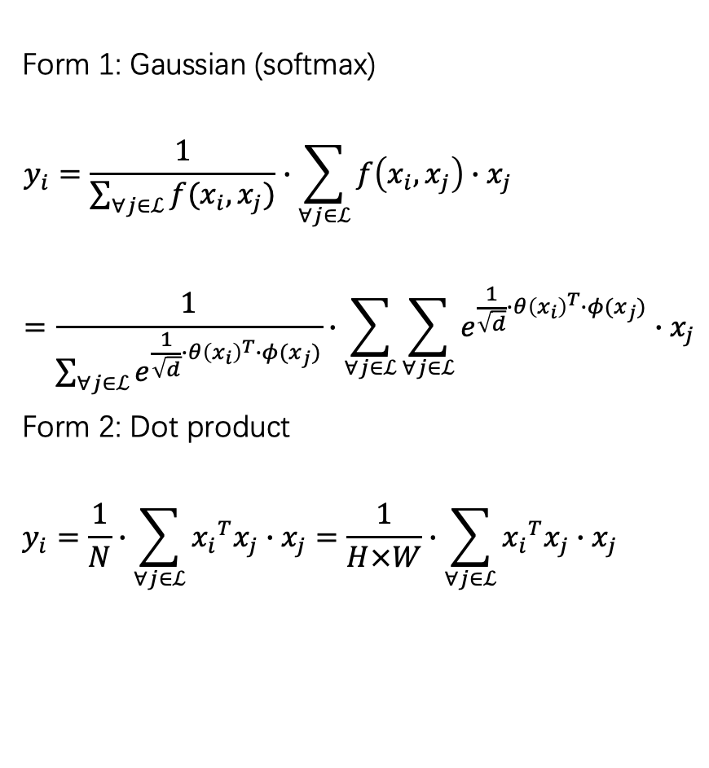
Denoising Block-Non-local Means Filter
Form 1: Gaussian (softmax)
$$y_{i}=\frac{1}{\sum_{∀j∈ℒ}{f(x_{i},x_{j})}}∙\sum_{∀j∈ℒ}{f\left(x_{i},x_{j}\right)∙x_{j}}=\frac{1}{\sum_{∀j∈ℒ}{e^{\frac{1}{\sqrt{d}}∙{θ\left(x_{i}\right)}^{T}∙φ(x_{j})}}}∙\sum_{∀j∈ℒ}{\sum_{∀j∈ℒ}{e^{\frac{1}{\sqrt{d}}∙{θ\left(x_{i}\right)}^{T}∙φ(x_{j})}}∙x_{j}}$$
Form 2: Dot product
$$y_{i}=\frac{1}{N}∙\sum_{∀j∈ℒ}{{x_{i}}^{T}x_{j}∙x_{j}}=\frac{1}{H×W}∙\sum_{∀j∈ℒ}{{x_{i}}^{T}x_{j}∙x_{j}}$$
$$y$$
Height: H
Width: W
Channel:256
Feature tensor $x$
Xie, Cihang, Wu, Yuxin, van der Maaten, Laurens. Feature Denoising for Improving Adversarial Robustness. CVPR 2018

Slide 26
实验

Slide 27
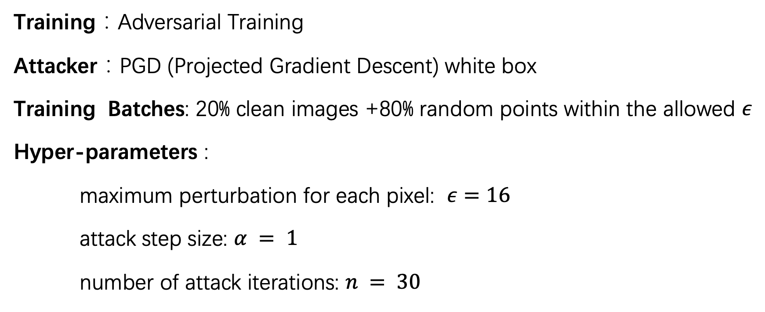
实验条件
Training：Adversarial Training
Attacker：PGD (Projected Gradient Descent) white box
Training Batches: 20% clean images +80% random points within the allowed $ε$
Hyper-parameters :
maximum perturbation for each pixel: $ε=16$
attack step size: $α = 1$
number of attack iterations: $n = 30$

Slide 28
实验条件
Training： Distributed Adversarial Training
Attacker： PGD (Projected Gradient Descent) +SGD (one-step) white box
Mini-batch: 100% perturbed images (32张)
Mini-batch number: 128（=GPU number）
Training Data set: ImageNet (1.28 million images in 1000 classes )
Epochs: 110 (35/70/95epoch时降低learning rate)
Model： ResNet-110 / ResNet-152
Training time: 38 hours(ResNet-110) / 52 hours (ResNet-152)

Slide 29
对比方案
ALP(previous state-of-the-art ) [10]
CAAD 2017 winner [15]
[10] H.Kannan, A.Kurakin, and I.Goodfellow. Adversarial logit pairing. arXiv preprint arXiv:1803.06373, 2018.
[15] F. Liao, M. Liang, Y. Dong, and T. Pang. Defense against adversarial attacks using high-level representation guided denoiser. In CVPR, 2018. 2, 7 (HGD)

Slide 30
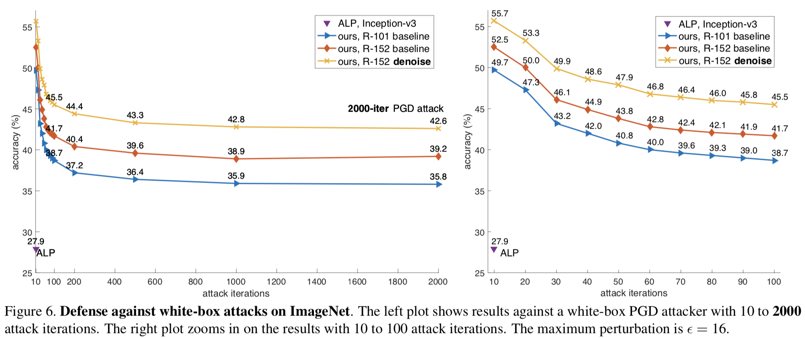
Against White-box Attack
Defense accuracy

Slide 31

Against White-box Attack

Slide 32

Against White-box Attack

Slide 33
Against Black-box attack
Evaluation criterion : CAAD 2018
“all-or-nothing”: an image is considered correctly classified only if the model correctly classifies all adversarial versions of this image created by all attackers.

Slide 34

Against Black-box attack

Slide 35

Against Black-box attack

Slide 36
思考
1. Feature Noise 难以定量测量，当防御模型的结构或训练方式发生改变，就不容易比较两个模型间feature noise的水平。
2.denoise block 对于干净图片分类的准确性影响很小。（没有提高）

